Slide 1

Chart My Course
Iteration 1
Harm Drenth, Warren Burrus, Anshpreet Kaur, Ricardo Boone, Tacoma Velez, Josh Wilson
Notes:
harm

Slide 2

Project Vision
Navigating college is hard. Navigating the choices of classes is even harder. Chart My Course seeks to simplify a Baylor Computer Science student’s choices of courses to take, as well as professors that teach them.
We intend to create a utility similar to the now defunct BUBooks that aggregates reviews of not just the course offerings, but also professor/course pairings. This utility is intended to give potential students a realistic look at what sort of coursework or workload they can expect in a class.
Notes:
Tacoma

Slide 3
Requirements: Functional
The user can create a new account, log in, and log out
The user can add a review of a professor
The user can search reviews of professors/courses
The user can request a review to be removed
The user can save lists of professors/courses
The user can post questions and answers in the Q&A board
The user can search for existing questions in the Q&A board
Notes:
Ricardo Boone

Slide 4
Requirements: Non-functional
The system shall not share the personal information of the author of posts to other users, only information the operators of the system receive is the author's name
All posts and user activity will be user friendly and comply to online community and safety guidelines
The courses and professors in the system will be limited to Baylor's Computer Science department
The system will adhere to all Baylor guidelines and policies
Notes:
Warren

Slide 5

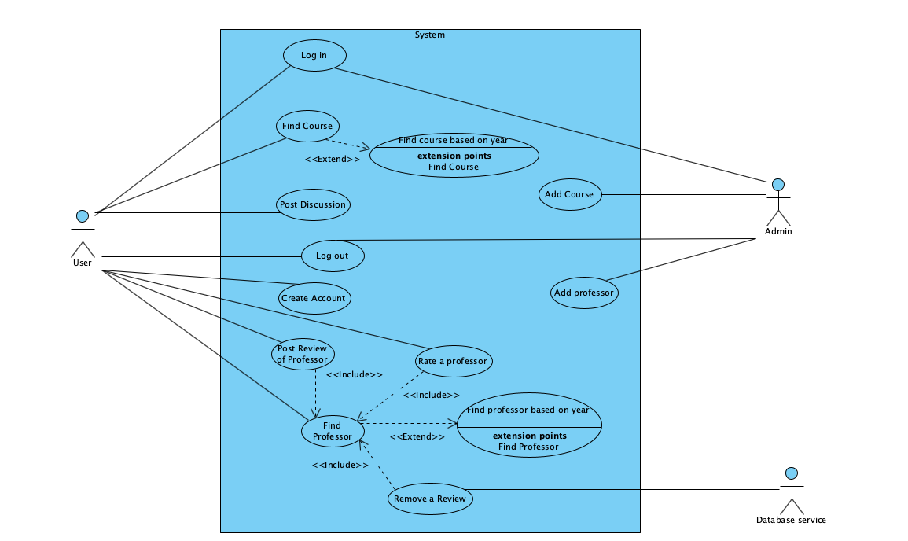



Use Case Diagram
Notes:
Anshpreet can present this slide!

Slide 6
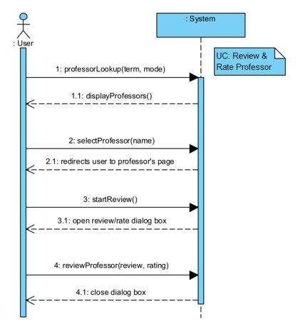
UC: Review and Rate Professor
Notes:
Josh?

Slide 7
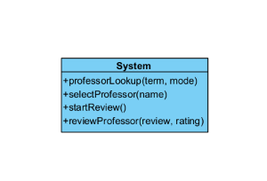
System Operations
Notes:
Josh?

Slide 8
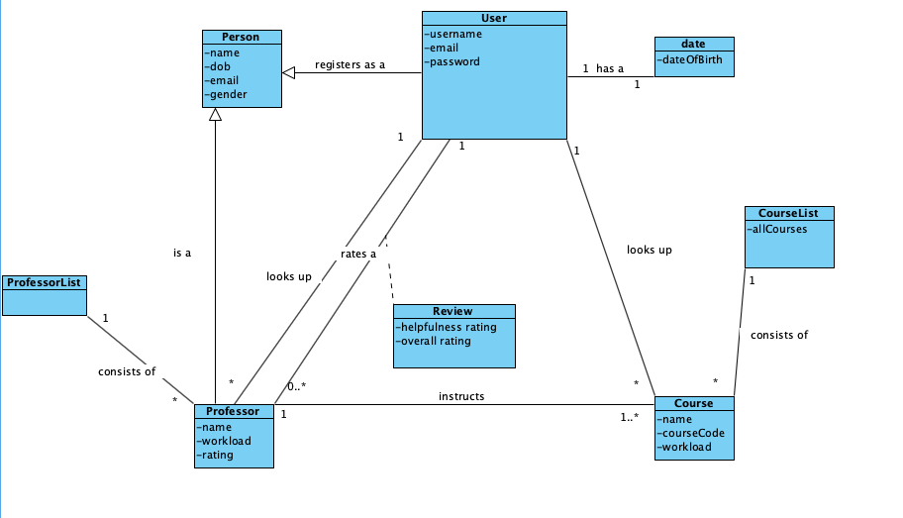
Domain Model
Notes:
Anshpreet will present this slide!
Explaination of how we came up with the domain model

Slide 9
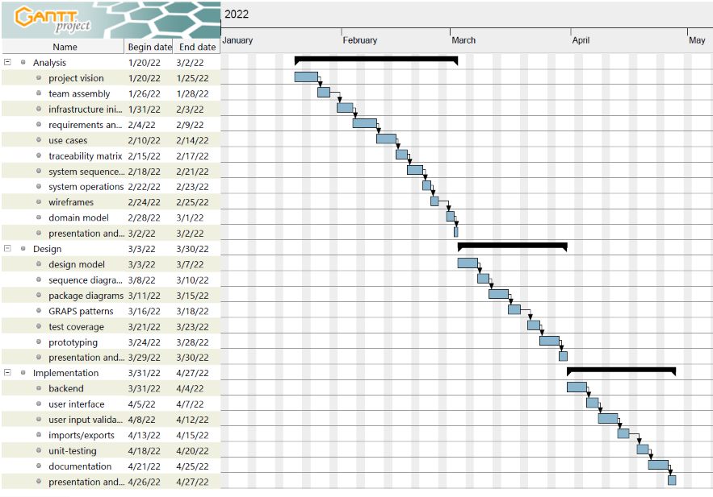
Gantt Diagram
Notes:
Warren

Slide 10
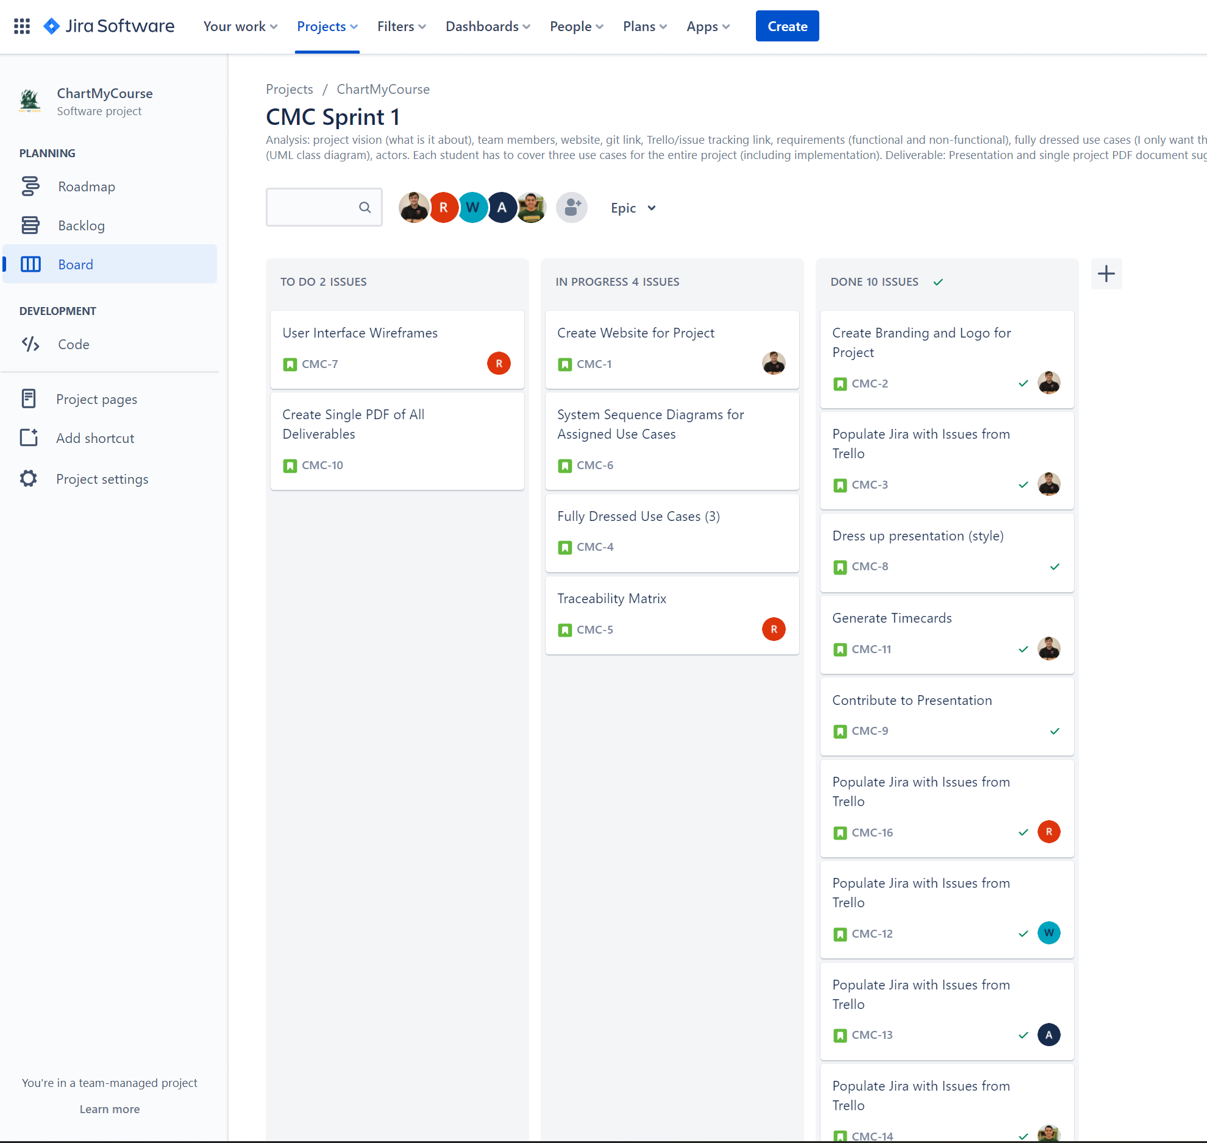
Time Management
Our team decided to use Atlassian’s Jira for time management, which easily allows us to track tasks and time spent
Jira link: https://chartmycourse.atlassian.net/
Notes:
Harm

Slide 11
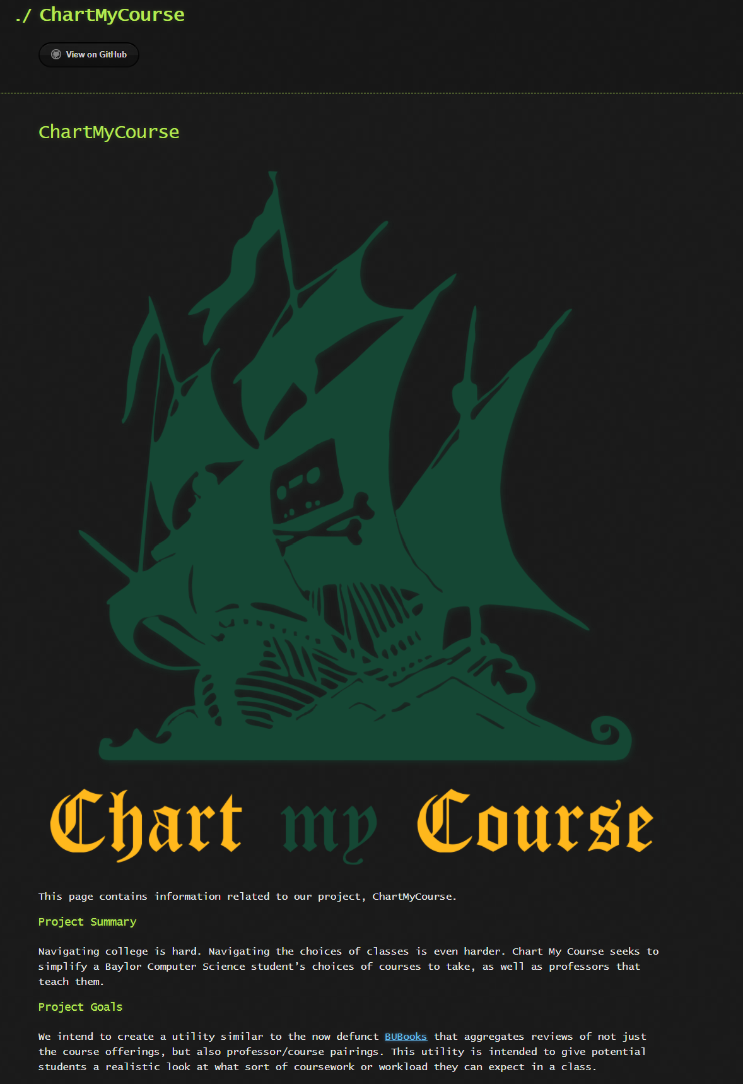
Website
Our project has a website, hosted at https://hkaase.github.io/ChartMyCourse/, to host the project and relevant information all in one place.
This website will be updated as the project progresses and should serve as a “state of the union” for the project.
Notes:
Harm

Slide 12
GitHub, Team Hours
Our GitHub repository can be found at https://github.com/hkaase/ChartMyCourse
Our timecard can be found at https://github.com/hkaase/ChartMyCourse/blob/main/Iteration%201/Resources/Timecard.pdf
Our website can be found at https://hkaase.github.io/ChartMyCourse/
Notes:
Harm

